Slide 1
Random-Key Cuckoo Search Algorithm (Discrete Cuckoo Search) for the TSP
Source: arXiv : 1607.04324v1 [cs.NE] 14 Apr 2016
Author : Aziz Ouaarab, Belaid Ahiod, Xin-She Yang
Presented by : R07546030 林詠軒

Slide 2
Contents
DCS VS ACO
Experimental results
Conclusion

Slide 3
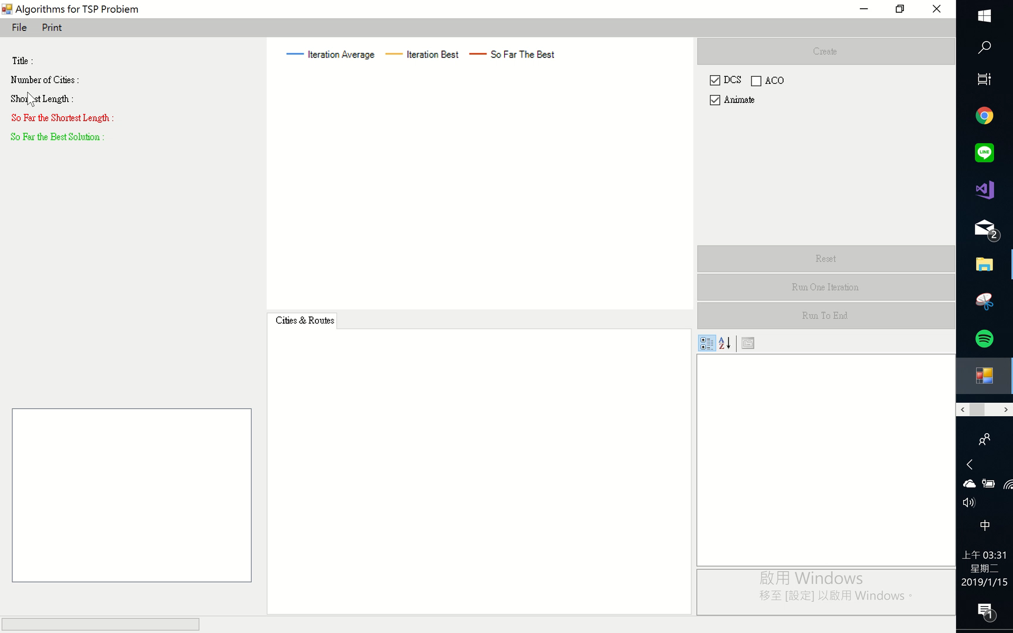
DCS

Slide 4
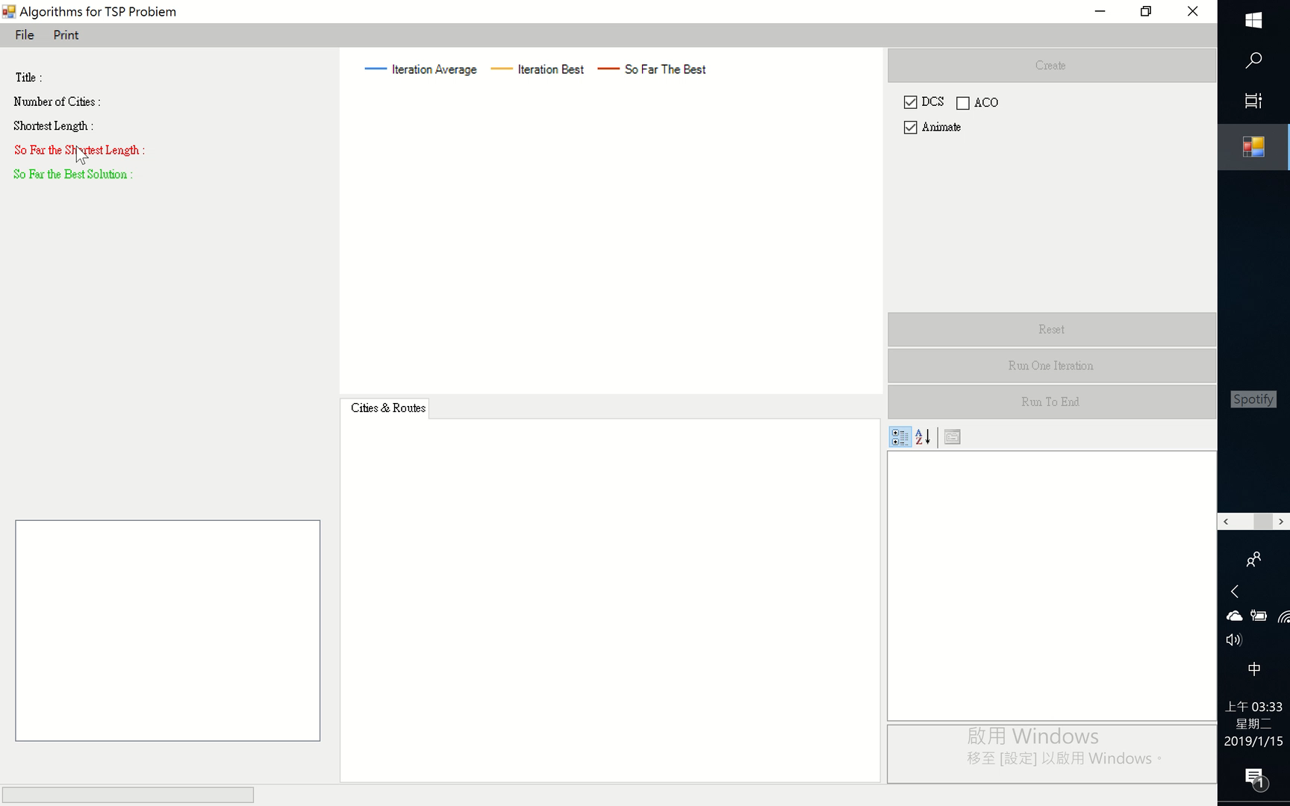
ACO

Slide 5
Experimental results
 | att48 |  | taiwan50 |  | berlin52 |  | eil51
 | ACO | DCS | ACO | DCS | ACO | DCS | ACO | DCS
1 | 10957 | 23164 | 1102 | 2773 | 7681 | 14204 | 455 | 933
2 | 11250 | 25110 | 1102 | 2901 | 7681 | 13528 | 451 | 912
3 | 11060 | 21951 | 1106 | 2743 | 7846 | 13973 | 463 | 945
4 | 11111 | 22534 | 1119 | 2614 | 7681 | 13204 | 464 | 947
5 | 11134 | 24464 | 1129 | 2624 | 7681 | 14582 | 457 | 912
6 | 11202 | 25417 | 1106 | 2693 | 7677 | 13405 | 463 | 910
7 | 11194 | 24847 | 1106 | 2723 | 7681 | 13735 | 457 | 865
8 | 11238 | 23203 | 1110 | 2672 | 7681 | 13881 | 459 | 890
9 | 10957 | 23454 | 1112 | 2816 | 7677 | 13773 | 464 | 888
10 | 11325 | 23286 | 1131 | 2740 | 7681 | 14467 | 458 | 870
Shortest | 10628 |  |  |  | 7544 |  | 430
Average | 11142.8 | 23743 | 1112.3 | 2729.9 | 7696.7 | 13875.2 | 459.1 | 907.2
Best | 10957 | 21951 | 1102 | 2614 | 7677 | 13204 | 451 | 865
Worst | 11325 | 25417 | 1131 | 2901 | 7846 | 14582 | 464 | 947

Slide 6
Conculsion
CS原本為解決連續優化問題，雖然經過改善，但用在TSP問題上效果不那麼好
布穀鳥雖會依照Levy flight尋找下個巢(城市)，但此公式沒有考量到距離問題，解決TSP問題上效率不那麼好

